Slide 1
INDIANA ELECTION TIME-SERIES DATA REVIEW
Draza Smith
8/26/2021

Slide 2
Data evaluated
The data used to create the following charts is gathered from the New York Times election data website.
The time-series e that can be found here for Indiana:
https://static01.nyt.com/elections-assets/2020/data/api/2020-11-03/race-page/indiana/president.json
It is freely available and is the data that was used by many TV stations and web pages to provide the real-time updates on the vote count.
Each time-stamp entry provides the following data:

Slide 3
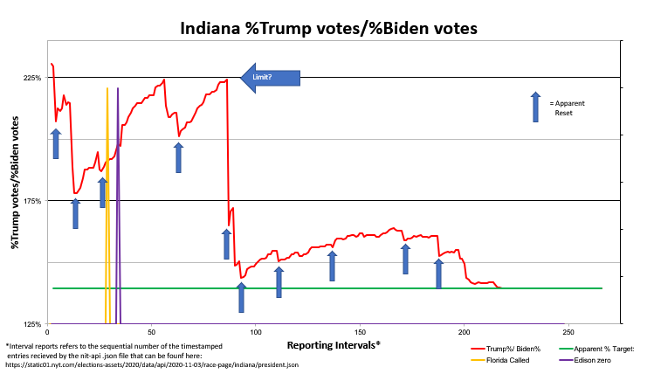
APPARENT PROPORTION CONTROL BETWEEN TRUMP AND BIDEN VOTES

Slide 4
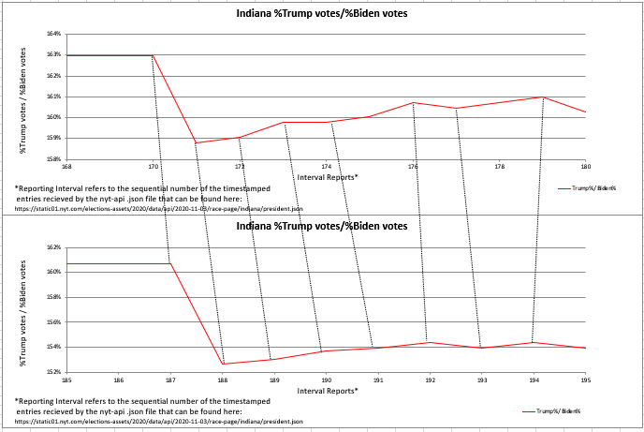
“RESET” event at 171 compared to Event at 188

Slide 5
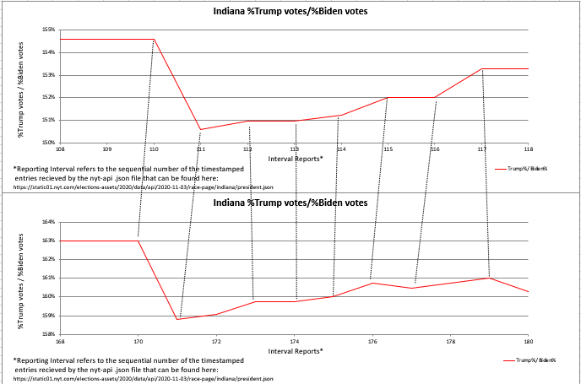
“RESET” event at 171 compared to Event at 188

Slide 6
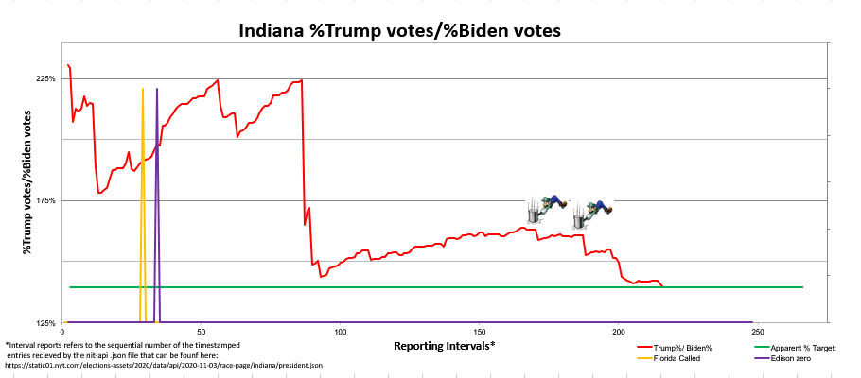
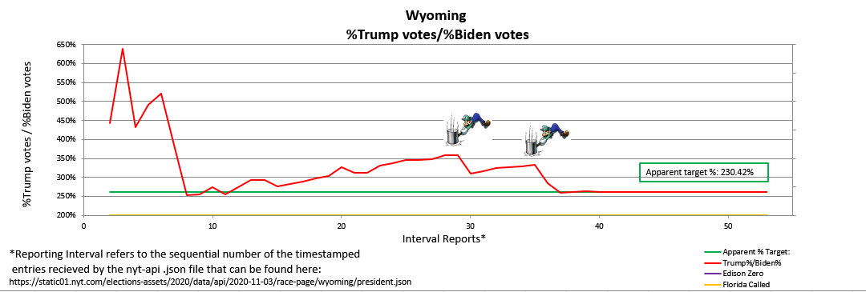
TOTAL VOTES FOR EACH CANDIDATE OVER TIME

Slide 7
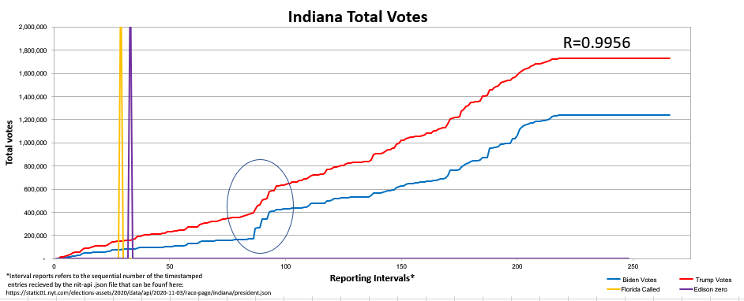
Correlation Between States

Slide 8
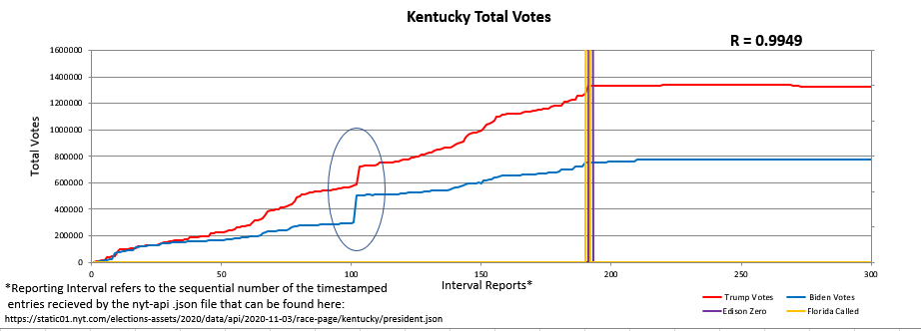
Correlation Between States

Slide 9
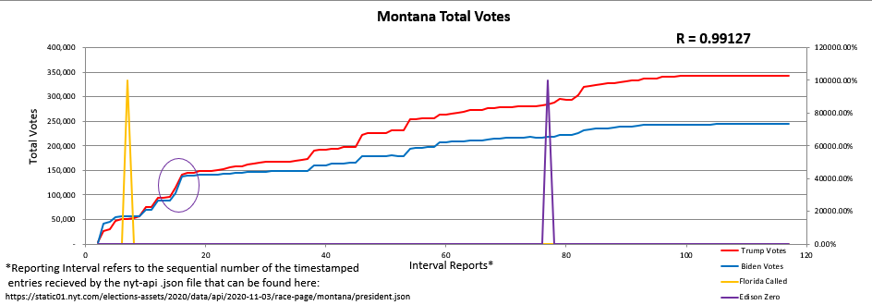
Correlation Between States

Slide 10
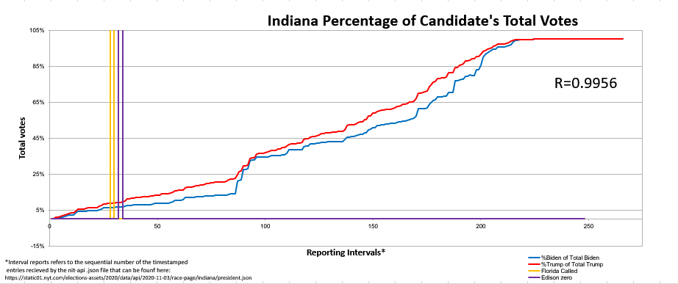
Percentage of Candidate votes over time

Slide 11
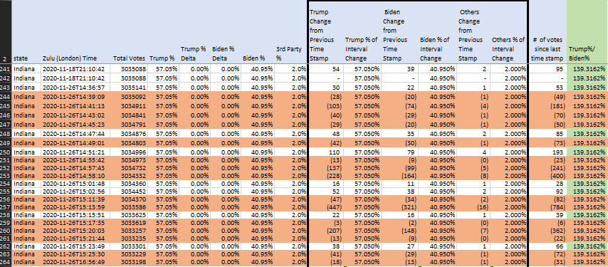
Vote reductions at the end of counting

Slide 12
Thank you!

